Slide 1

ACNS Critical Care EEG Terminology
Training Module 2021, Part 2 of 3
Markus Leitinger, MD
Department of Neurology, Christian Doppler University Hospital
Center for Cognitive Neuroscience
Paracelsus Medical University
Salzburg, Austria
Michael W.K. Fong, MBBS
Westmead Comprehensive Epilepsy Unit
Westmead Hospital
University of Sydney
Sydney, Australia
Lawrence J. Hirsch, MD
Comprehensive Epilepsy Center
Department of Neurology
Yale University School of Medicine,
New Haven, CT, USA

Slide 2
Mode of presentation
General remarks:
This module has been designed to provide a self guided introduction to the important components of the ACNS standardized critical care EEG terminology, 2021 version. It focuses on discussing terms that are commonly used or with a high clinical importance. It does not describe all of the major and minor modifiers (although it includes many). For comprehensive details on all feaures of the terminology please refer to the ACNS guideline that can be found at https://www.acns.org/practice/guidelines, under “Continuous EEG Monitoring in Critical Care“, or via the Journal of Clinical Neurophysiology https://journals.lww.com/clinicalneurophys/Fulltext/2021/01000/American_Clinical_Neurophysiology_Society_s.1.aspx

Slide 3
Contents, Part 2 of 3
Sequence of topics (follows the full guideline):
A. EEG BACKGROUND
B. SPORADIC EPILEPTIFORM DISCHARGES
C. RHYTHMIC AND PERIODIC PATTERNS (RPPs)
D. ELECTROGRAPHIC AND ELECTROCLINICAL SEIZURES [NEW, 2021]
E. BRIEF POTENTIALLY ICTAL RHYTHMIC DISCHARGES (BIRDs) [NEW, 2021]
F. ICTAL-INTERICTAL CONTINUUM (IIC) [NEW, 2021]
Sequence of slides for each topic:
1. Introductory text plus diagram
2. EEG example alone with question at the bottom
3. EEG with explanatory annotations
4. Summary slide

Slide 4
C. Rhythmic and
Periodic Patterns (RPPs)

Slide 5
RHYTHMIC AND PERIODIC PATTERNS (RPPs): MAIN TERMS
All rhythmic and periodic patterns (RPPs) should be described by main terms 1 and 2, as well as appropriate major and minor modifiers. Not all modifiers will apply to every pattern.
Main term #1 (localization) (G) Generalized (L) Lateralized (BI) Bilateral Independent (Mf) Multifocal | Main term #2 (pattern) (PDs) Periodic Discharges (RDA) Rhythmic Delta Activity (SW) (Poly)Spike-&-Wave/Sharp- and-Wave
NEW 2021:
(UI) Unilateral Independent

Slide 6
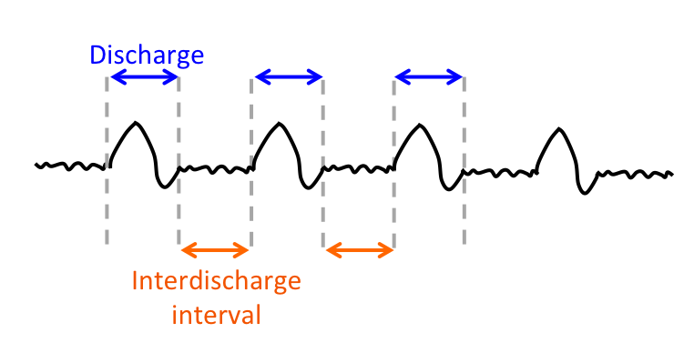
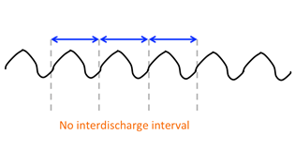
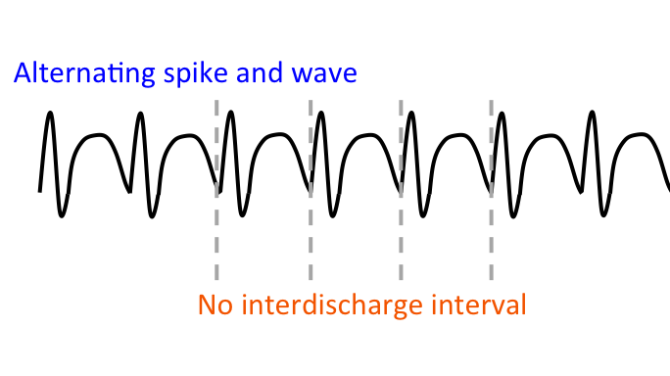
RHYTHMIC AND PERIODIC PATTERNS (RPPs): MAIN TERM 2
Main term 2 (pattern description) includes:
  PD: Periodic Discharges
  RDA: Rhythmic Delta Activity
  SW: Spike-and-Wave, Sharp-and-Wave or
Polyspike-and-Wave

Slide 7
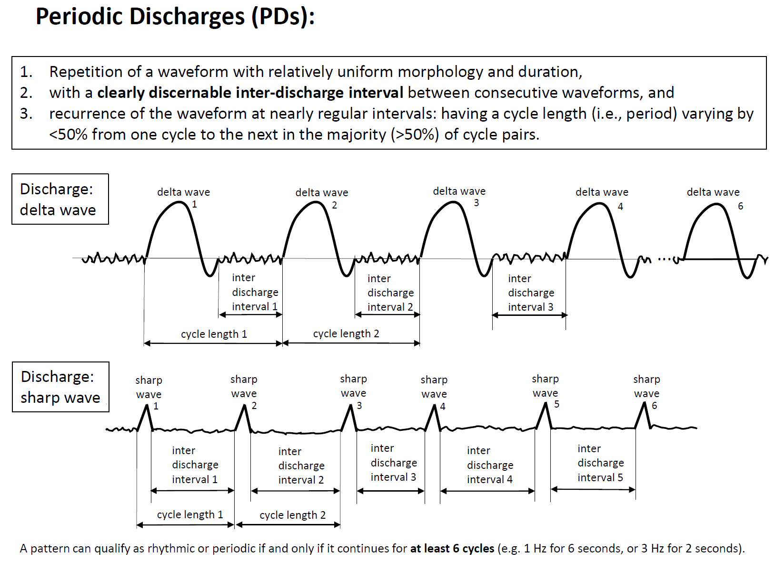
MAIN TERM 2: PDs
NOTE: PDs can be blunt as shown in first example. (Blunt: having a smooth or sinusoidal morphology.)

Slide 8
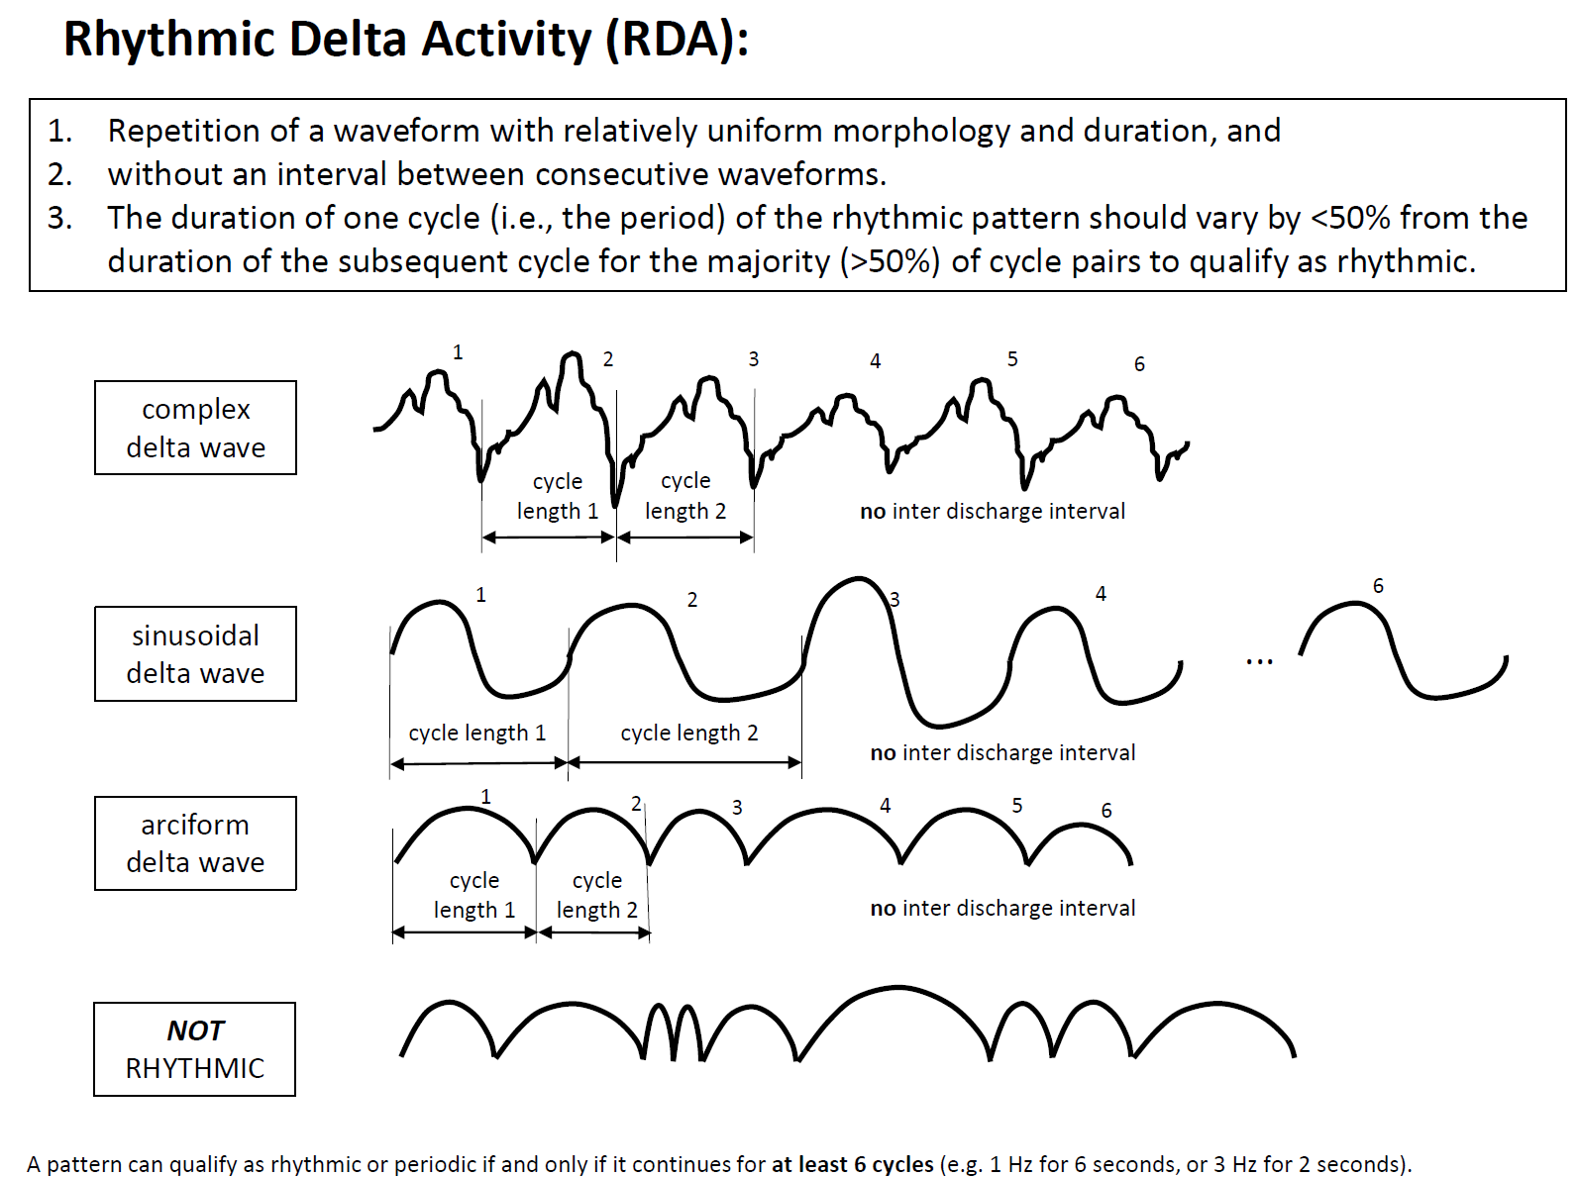
MAIN TERM 2: RDA
polymorphic, also known as
irregular or arrhythmic
NOT RDA

Slide 9
MAIN TERM 2: SW
Spike-and-wave or Sharp-and-wave (SW): Polyspike, spike or sharp wave consistently followed by a slow wave in a regularly repeating and alternating pattern (spike-wave-spike-wave-spike-wave), with a consistent relationship between the spike (or polyspike or sharp wave) component and the slow wave for at least 6 cycles; and with no interval between one spike-wave complex and the next (if there is an interval, this would qualify as PDs, where each discharge is a spike-and-wave).
Spike-and-Wave Sharp-and-Wave
Longitudinal bipolar
1
2
3
4
5
6
1
2
3
4
5
6
20 to <70 ms
70 to 200 ms
duration measured at baseline
duration measured at baseline

Slide 10
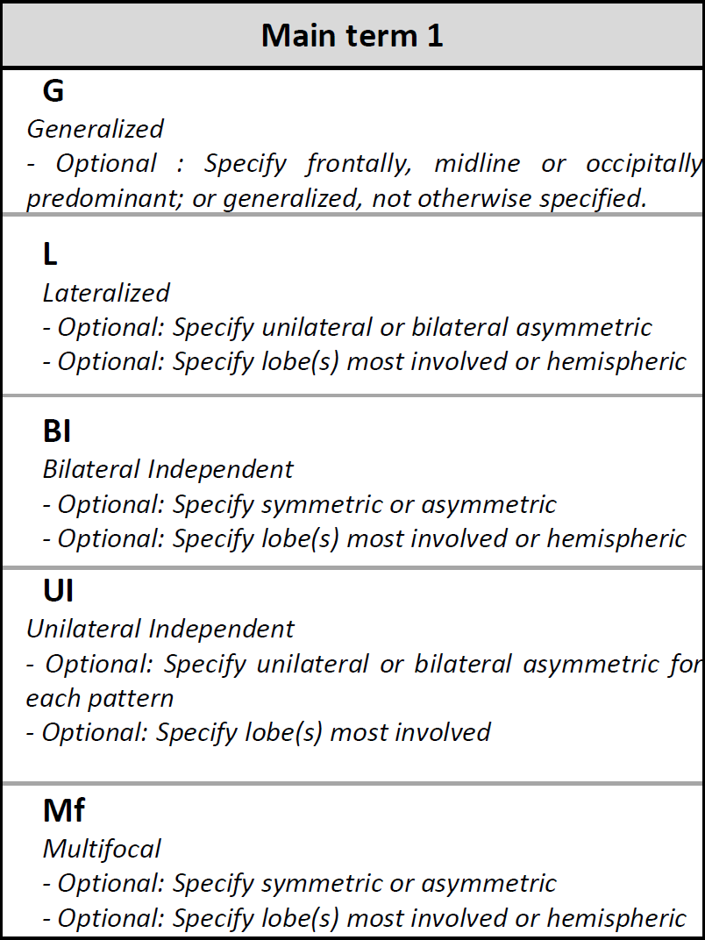
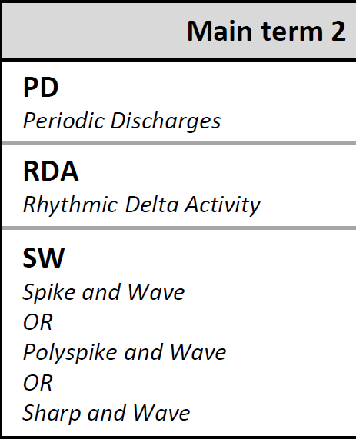

MAIN TERM 1: GENERALIZED
LEFT
Generalized: Bilateral synchronous and symmetric periodic discharges. In this case the pattern is “frontally predominant“
Longitudinal bipolar montage
RIGHT
Main term 1 (localization) terms have been demonstrated with periodic discharges (PDs).
In practice, any main term 1 can be combined with any main term 2

Slide 11
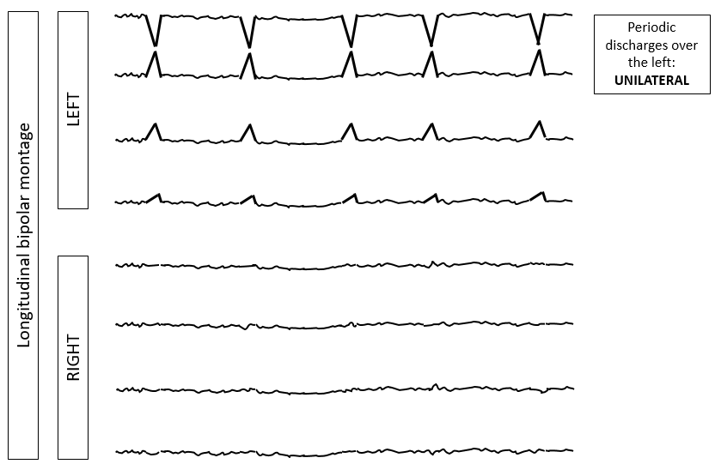
MAIN TERM 1: LATERALIZED

Slide 12
MAIN TERM 1: BILATERAL INDEPENDANT
Periodic discharges over the left
LEFT
Longitudinal bipolar montage
Independent periodic discharges over the right
RIGHT
Note: In BIPDs, lateralized patterns occur on each hemisphere asynchronously and at different frequencies.

Slide 13
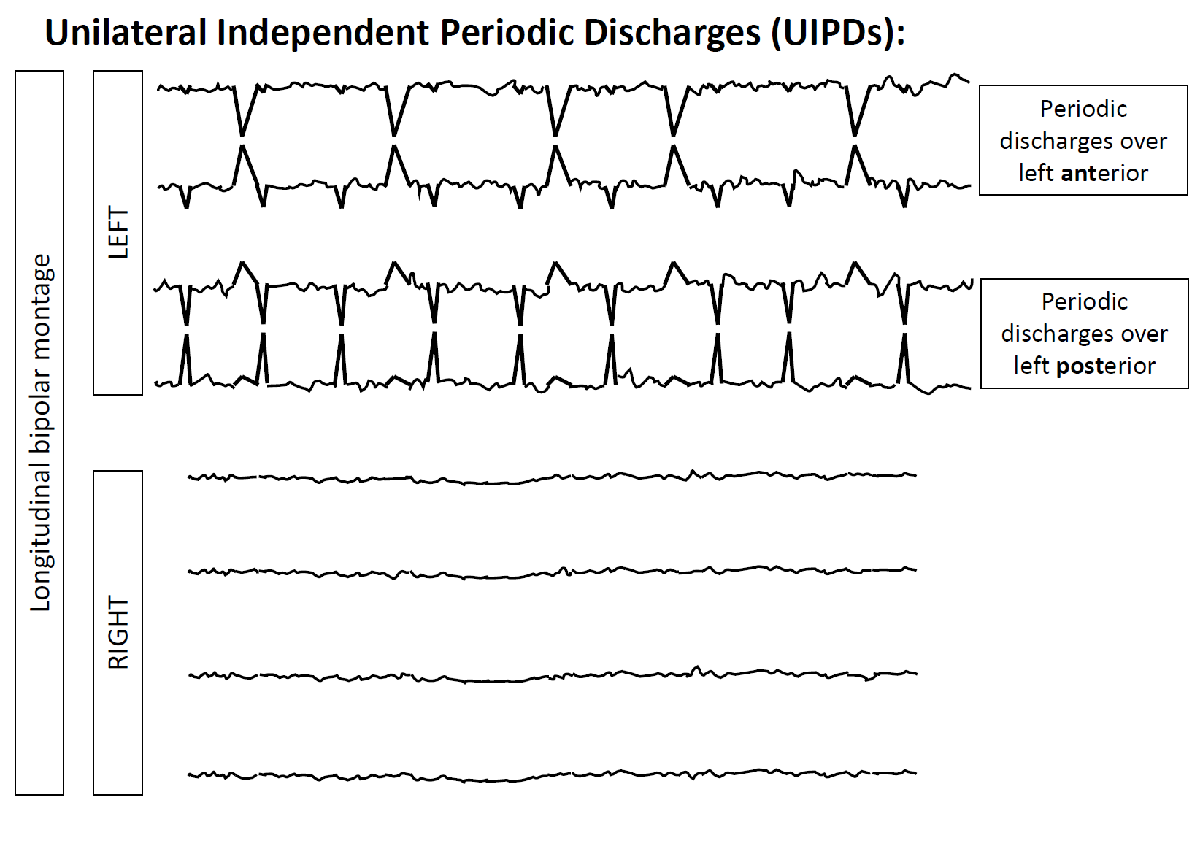
MAIN TERM 1: UNILATERAL INDEPENDANT
Note: In UIPDs, 2 or more lateralized patterns occur within the same hemisphere asynchronously and at different frequencies.

Slide 14
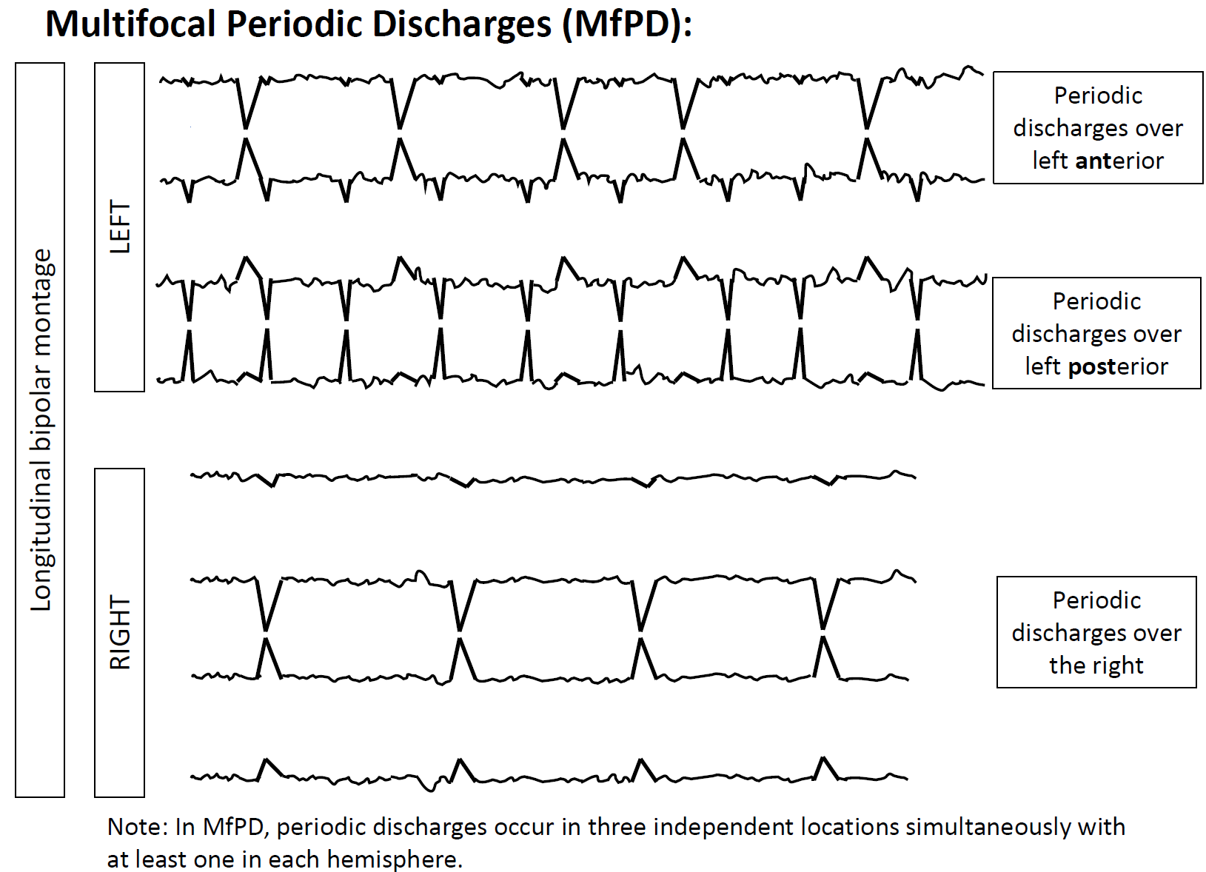
MAIN TERM 1: MULTIFOCAL

Slide 15
MAJOR MODIFIERS
In addition to main terms 1 and 2, the following major modifiers can be applied to refine the description of the pattern:
  Prevalence
  Duration
  Frequency
  Phases
  Sharpness
  Voltage
  Stimulus-Induced (SI-) or Stimulus-Terminated (ST-) (new in 2021)
  Evolution
  Plus (+)

Slide 16
FREQUENCY/DURATION/PREVALENCE
Note that there are 4 distinct time-related scales:
  1. Frequency
    refers to the rate per second or the number of cycles of a pattern within 1 second. Maximum, minimum, and typical frequencies can be recorded. Frequencies are expressed in hertz (Hz) that equates with cycles per second.
    <0.5, 0.5, 1, 1.5, 2, 2.5, 3, 3.5, and 4 Hz
  2. Duration
    refers to the typical duration of a single occurrence of the pattern, regardless of whether the pattern occurs rarely or frequently, categorized as:
  very long, long, intermediate duration, brief, very brief
  3. Prevalence
  refers to percent of the entire record occupied by a pattern, categorized as:
  continuous, abundant, frequent, occasional, rare
    The best estimate of prevalence, when given as a single number, is also known as the “burden” of that pattern. E.g., seizure burden of 40%, or IIC burden of 40%, or PD burden of 40%.
  4. Quantification of sporadic epileptiform discharges
    refers to how often sporadic (non-periodic) epileptiform discharges are present in the record, categorized as:
  abundant, frequent, occasional, rare

Slide 17
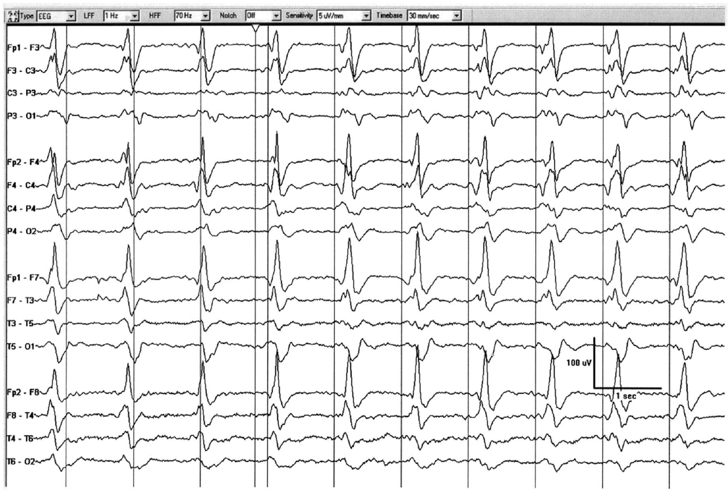
What pattern is this?

Slide 18
Frontal predominance
10 discharges in
10 seconds → 1 Hz
Sharp morphology
110 ms
DISCHARGE:
< 0.5s,
regardless of phases
440 ms
Generalized Periodic Discharges, GPDs (frontally predominant, sharp, 1 Hz)

Slide 19
Frontal predominance
It is still a “discharge“ despite exceeding 0.5s as it has only 3 phases (colored).
Sharp morphology
110 ms
10 discharges in
10 seconds → 1 Hz
DISCHARGE:
≥ 0.5s BUT ≤ 3 phases
510 ms
3 phases (blue green, orange)
Generalized Periodic Discharges, GPDs (frontally predominant, sharp, 1 Hz, 3 phases)

Slide 20
PERIODIC DISCHARGES: SHARPNESS
Applies to PDs and the S phase of SW
spiky
~60 ms
~170 ms
sharp
1 second
Sharpest phase: spiky (<70 ms)
Predominant phase (greatest amplitude): sharp (70-200 ms)

Slide 21
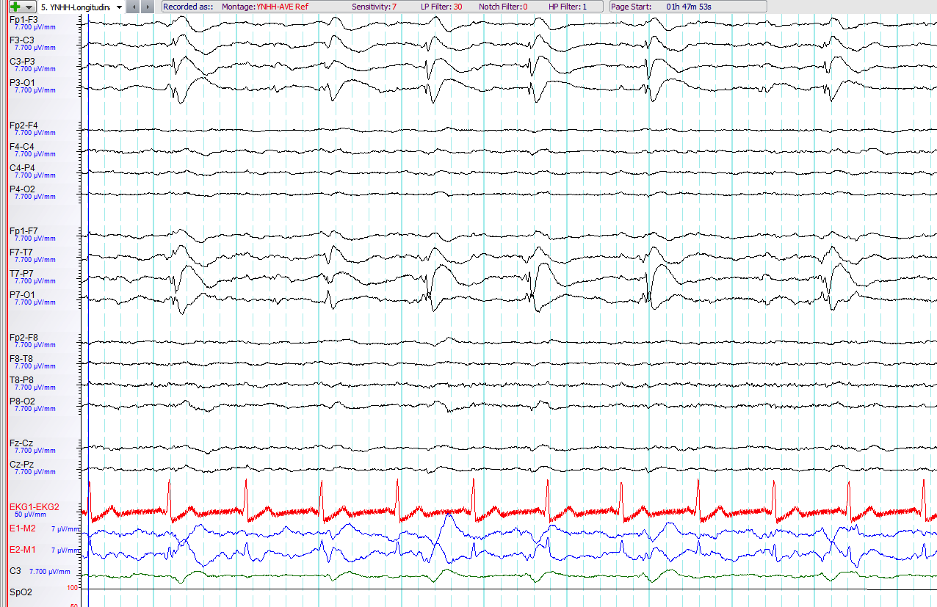
Please characterize the pattern

Slide 22
Morphology of one discharge: spike-and-wave, but pattern is LPDs
LATERALIZED PERIODIC DISCHARGES
Lateralized Periodic Discharges, LPDs
(spiky, with spike-and-wave morphology)
Despite their spike-and-wave morphology, these are PDs (not SW) as there is a clear interdischarge interval

Slide 23
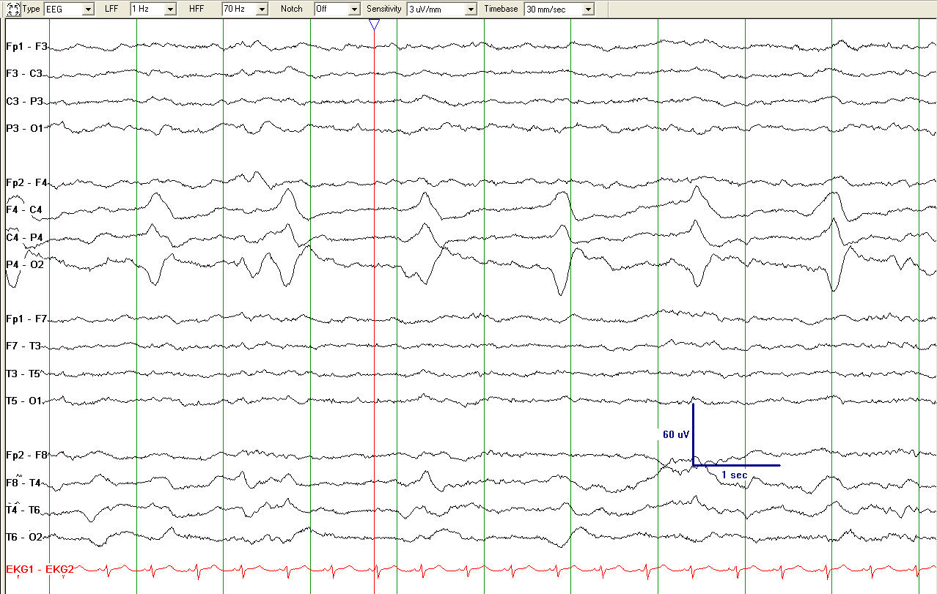
Lateralized Periodic Discharges (LPDs)
Please describe this pattern

Slide 24
Sharpness: SHARPLY CONTOURED
as duration > 0.2 s
~ 0.37 s
7 EDs/10.5 s= 0.67 → 0.5-1 Hz
Lateralized Periodic Discharges (LPDs)
Lateralized Periodic Discharges, LPDs (right parietal maximum, sharply contoured, positive polarity, 0.5 - 1 Hz) NOTE: even though the dischages are sharply contoured (i.e., not spiky or sharp), they are still a periodic pattern (LPDs here).

Slide 25
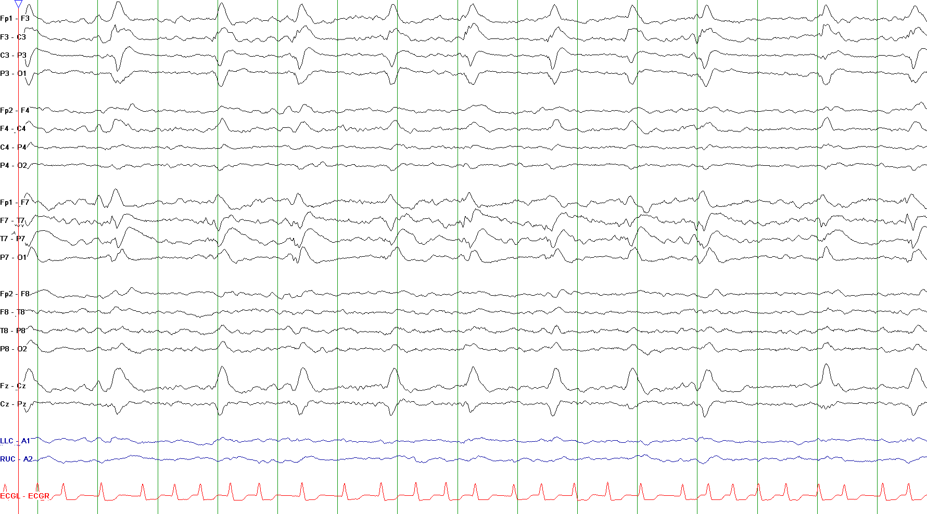
Please characterize the pattern

Slide 26
LATERALIZED (bilateral asymmetric):
bilateral, but clearly and consistently higher amplitude in left hemisphere = LATERALIZED. [Consistently: >80% of the time.]
PERIODIC:
with interdischarge intervals, in green circles
DISCHARGES:
here: duration ≥500 ms but only one or two phases, therefore still discharges, not bursts.
Lateralized Periodic Discharges, LPDs
(bilateral asymmetric, 0.5-1 Hz)

Slide 27
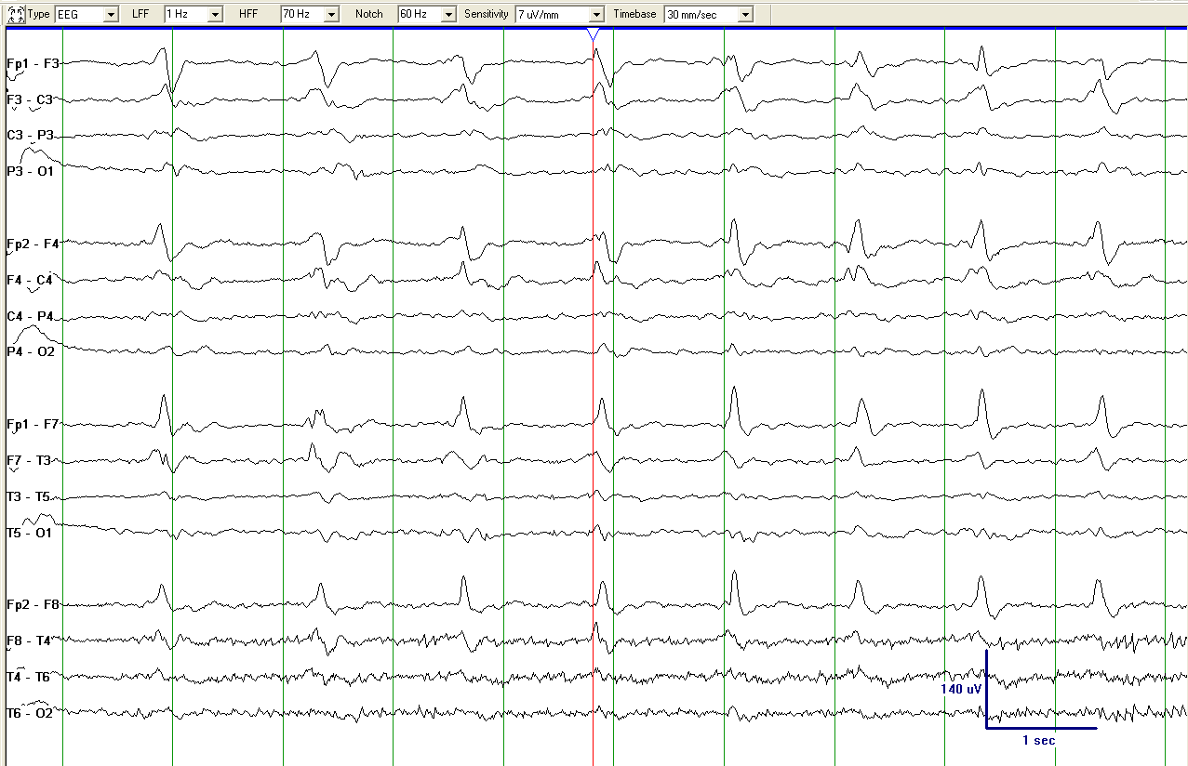
Generalized Periodic Discharges (GPDs)
What would you call this pattern?

Slide 28
higher on RIGHT
Note that the term “generalized“ allows for higher voltage on one side if there are also discharges with higher voltages on the other side (“shifting predominance“ or more specific “shifting asymmetry“).
If the asymmetry clearly and consistently favors one hemisphere then this would be “lateralized - bilateral asymmetric“; that is not the case here.
higher on LEFT
Generalized Periodic Discharges (GPDs)
Generalized Periodic Discharges (GPDs), with shifting asymmetry
(bifrontal maximal, sharp, 1.0 Hz)

Slide 29
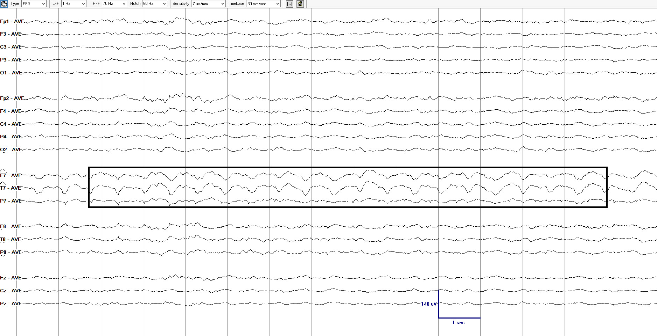
What is the correct term for this pattern?
Reproduced with permission from Hirsch LJ, Fong MWK, Brenner RP. Atlas of EEG in Critical Care, second edition, Wiley: 2022

Slide 30
Lateralized Rhythmic Delta Activity (LRDA)
(Left anterior-mid temporal maximum, 1.5 Hz)
Reproduced with permission from Hirsch LJ, Fong MWK, Brenner RP. Atlas of EEG in Critical Care, second edition, Wiley: 2022

Slide 31
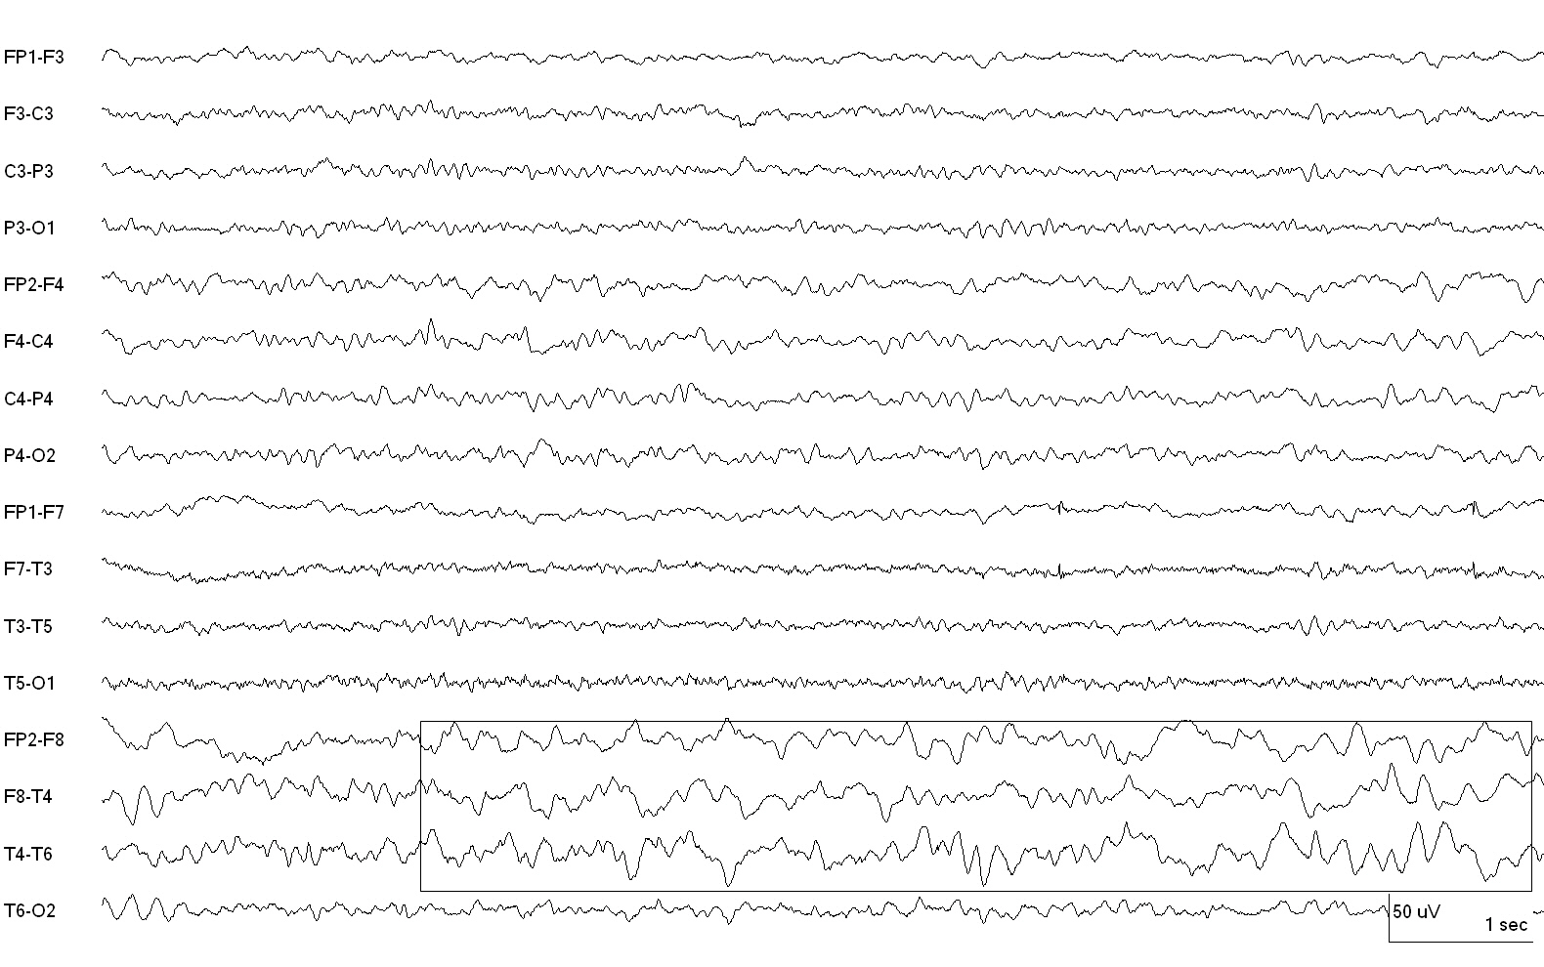
Please describe the pattern:
Reproduced with permission from Hirsch LJ, Fong MWK, Brenner RP. Atlas of EEG in Critical Care, second edition, Wiley: 2022

Slide 32
Polymorphic delta activity (a.k.a. irregular, arrhythmic)
(This is NOT LRDA; RDA has to be rhythmic. This is just focal slowing)
Reproduced with permission from Hirsch LJ, Fong MWK, Brenner RP. Atlas of EEG in Critical Care, second edition, Wiley: 2022

Slide 33
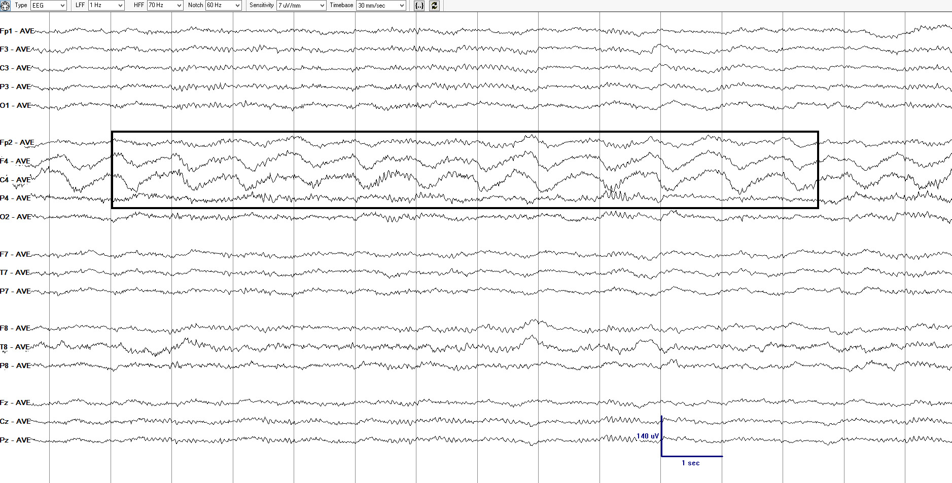
Please describe the pattern
Reproduced with permission from Hirsch LJ, Fong MWK, Brenner RP. Atlas of EEG in Critical Care, second edition, Wiley: 2022

Slide 34
(Advanced comment: The fast activity is present even after the RDA ends; thus, this is not +F, just LRDA with no plus. This also means it can not be Extreme Delta Brush pattern.)
Lateralized Rhythmic Delta Activity, LRDA
(Right frontocentral maximum, 1.0 Hz)
Reproduced with permission from Hirsch LJ, Fong MWK, Brenner RP. Atlas of EEG in Critical Care, second edition, Wiley: 2022

Slide 35
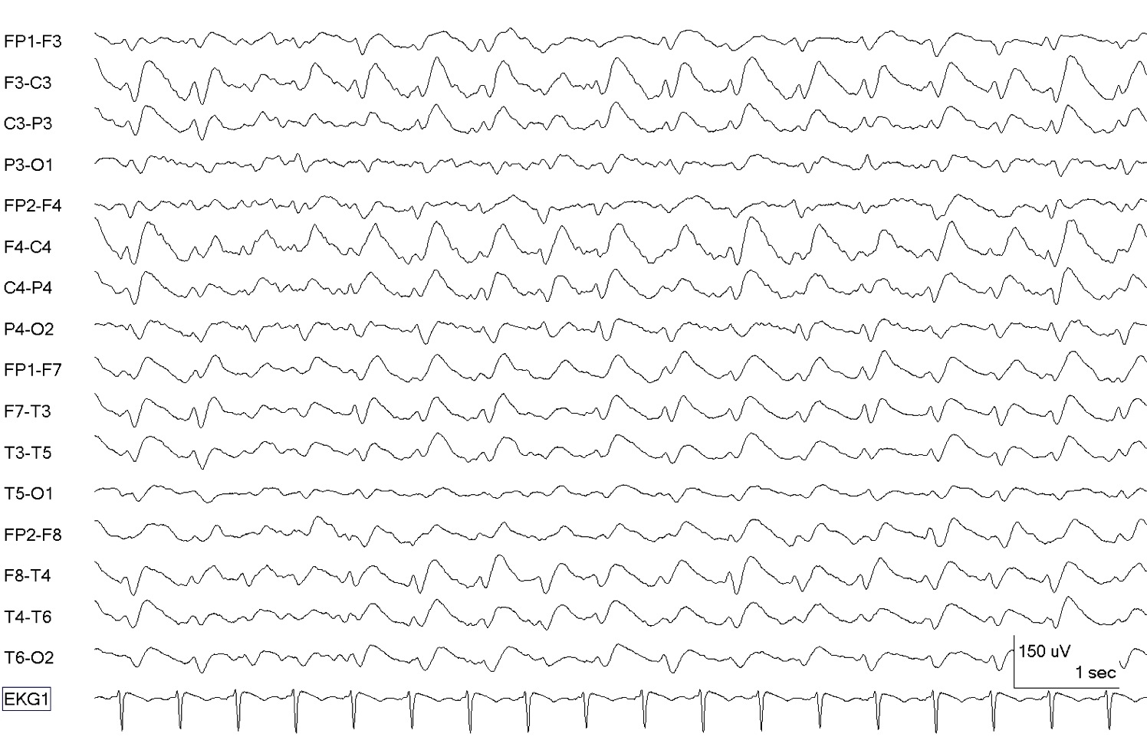
What is the correct term for this pattern?

Slide 36
17 EDs/10 s
→ 1.5 Hz
Sharp-and-wave: NO interdischarge intervals
SHARP
90 ms
Generalized sharp-and-wave, GSW
(bifrontal maximum, 1.5 Hz)

Slide 37
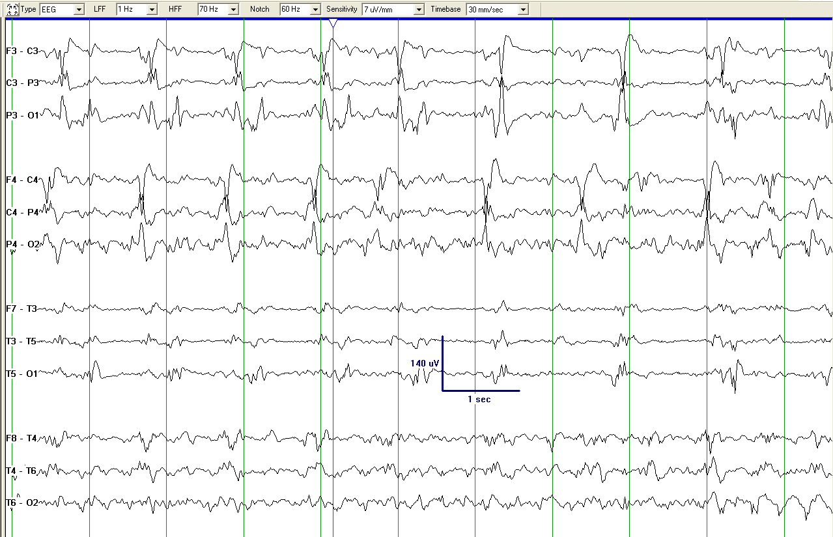
What pattern(s) is this?

Slide 38
Left centroparietal
Right central
BIPDs
Lateralized Periodic Discharges (LPDs)
Bilateral Independent Periodic Discharges BIPDs

Slide 39
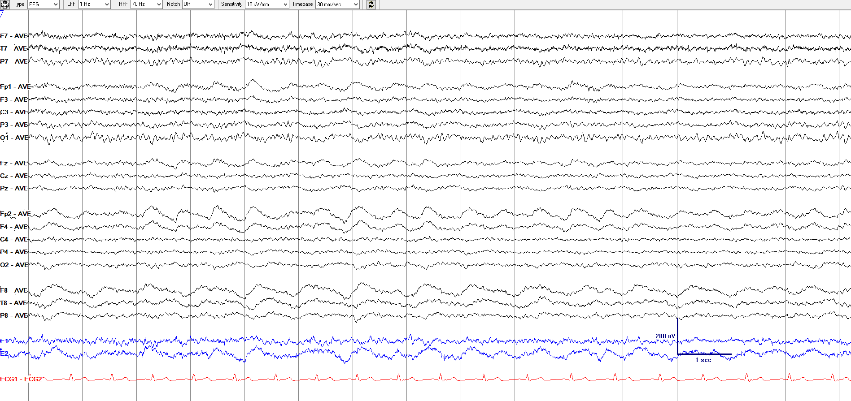
What is the correct term for this pattern?

Slide 40
Unilateral Independant Rhythmic Delta Activity, UIRDA
(Right frontopolar maximum [solid lined box]: 1.5 Hz; Right anterior temporal maximum [dashed box]: 1.0 Hz)
Advanced comment: The fast activity is diffuse and NOT time-locked to the RDA, therefore NO plus and NO delta-brush pattern.

Slide 41
What would you call this pattern?

Slide 42
Left frontal
12 EDs/10 s
→ 1.0 Hz
Vertex
5 EDs/10 s
→ 0.5 Hz
Focal midline patterns can be deemed in the same
hemisphere (ipsilateral) as an independent pattern in either the left or right hemisphere.
For example, PDs at 1 Hz in the left hemisphere occurring simultaneously with independent focal midline PDs at 0.5 Hz would still qualify as unilateral independent periodic discharges.
Unilateral Independent Periodic Discharges, UIPDs
(orange: maximum left frontal, 1.0 Hz; green: maximum at vertex [Cz], 0.5 Hz)

Slide 43
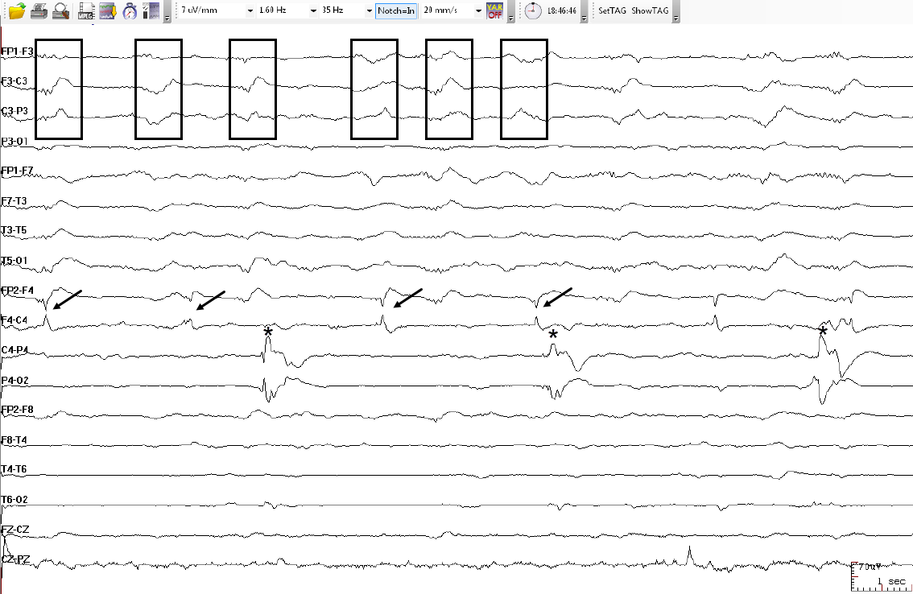
This pattern is best classified as:
Courtesy of
Dr. Luis Octavio Caboclo

Slide 44
Left frontal, ~1 Hz
Right frontal, ~0.5 Hz
Right parietal, ~0.3 Hz
Multifocal Periodic Discharges, MfPDs: 3 independent foci, 1 left, 2 right
Courtesy of
Dr. Luis Octavio Caboclo

Slide 45
MAJOR MODIFIERS: PREVALENCE
How often and how long a pattern is present can be described by prevalence and duration:
Prevalence: The percent of the record or epoch that includes the pattern, using the following divisions:
  >90% Continuous
  50-89% Abundant
  10-49% Frequent
  1-9% of Occasional
  <1% of Rare

Slide 46
MAJOR MODIFIERS: DURATION
Typical duration of pattern: The typical duration of a pattern, using the following divisions: (i.e., how long a pattern typically lasts)
  >1 hour Very long
  10-59 min Long [2021 revision, to match ILAE def’n of status epilepticus that is not convulsive (10 min)]
  1-9.9 min Intermediate duration
  10-59 sec Brief
  <10 sec Very brief

Slide 47
“PLUS” MODIFIER
The Plus modifier refers to additional features that render the pattern more ictal-appearing than the same pattern without the plus. The Plus modifier can be characterized as:
  +F superimposed fast activity
  (theta or faster; for PDs or RDA)
  +R superimposed rhythmic or quasi rhythmic delta activity (for PDs only)
  +S superimposed sharp waves/spikes (at least >1/10s but not periodic and not spike-and-wave, SW) or sharply contoured (for RDA only)
  +FR if both subtypes apply (for PDs only)
  +FS if both subtypes apply (for RDA only)

Slide 48
PERIODIC DISCHARGES PLUS FAST (PDs+F)
code as +F if the fast activity is part of the RDA or PD pattern and not simply part of the background activity
EXAMPLE A: PDs+F
fast activity associated with each discharge
Longitudinal bipolar
EXAMPLE B: PDs+F
4
5
6
Longitudinal bipolar
OR …
NOTE: fast activity cycling with the periodic discharge

Slide 49
code as +F if the fast activity is part of the RDA or PD pattern and not simply part of the background activity
EXAMPLE C: PDs+F
Longitudinal bipolar
EXAMPLE D: PDs (NOT +F, as fast activity is part of the background and present even when the pattern is not)
4
5
6
Longitudinal bipolar

Slide 50
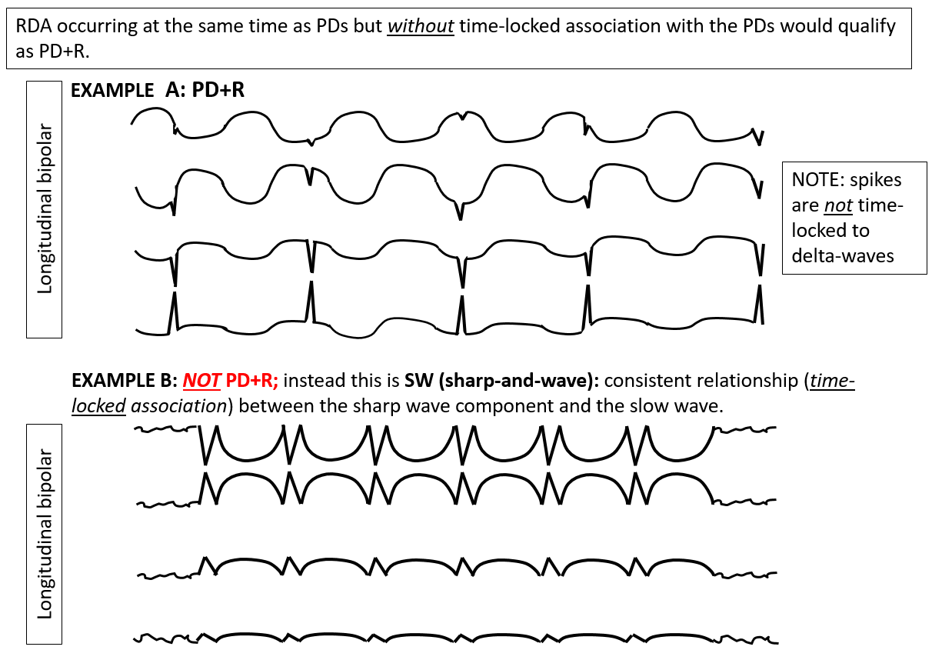
PERIODIC DISCHARGES PLUS RDA (PDs+R)

Slide 51
RHYTHMIC DELTA ACTIVITY PLUS SPIKES or SHARP WAVES (RDA+S)
Rhythmic delta activity (in this case over the left hemisphere) with associated spikes.
NOTE the discharges are not periodic (compared to example A, prior slide). If a pattern qualifies as PDs+R and RDA+S it is suggested that it be classified as PDs+R. If the spike/sharp component forms a stereotyped relationship with each wave and there is no inter-discharge interval it would likely qualify as SW (example B, prior slide)
LEFT

Slide 52
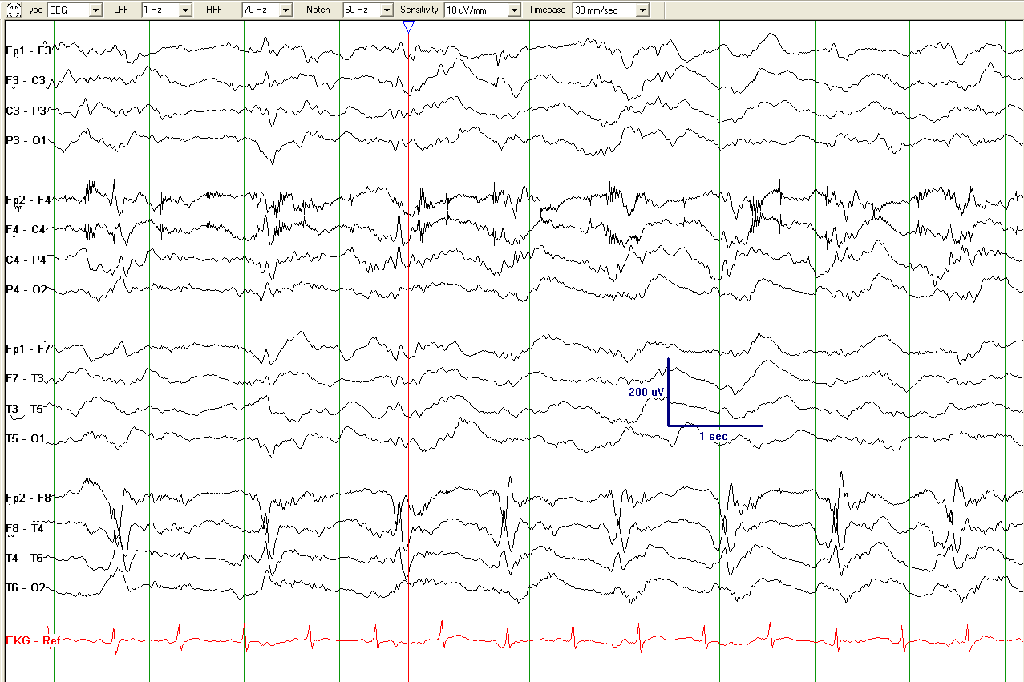
Spiky LPDs+F
Please describe the pattern

Slide 53
Artifact
Fast activity:
Spiky LPDs+F
Lateralized Periodic Discharges with superimposed fast activity, LPD+F
(Lateralized: bilateral asymmetric, right temporal maximum, 1 Hz)

Slide 54
What is the best way to describe this pattern?

Slide 55
Left LRDA, 1.5-2 Hz
Lateralized Rhythmic Delta Activity, LRDA+S
(it`s +S due to the sharp waves shown by the asterisks)

Slide 56
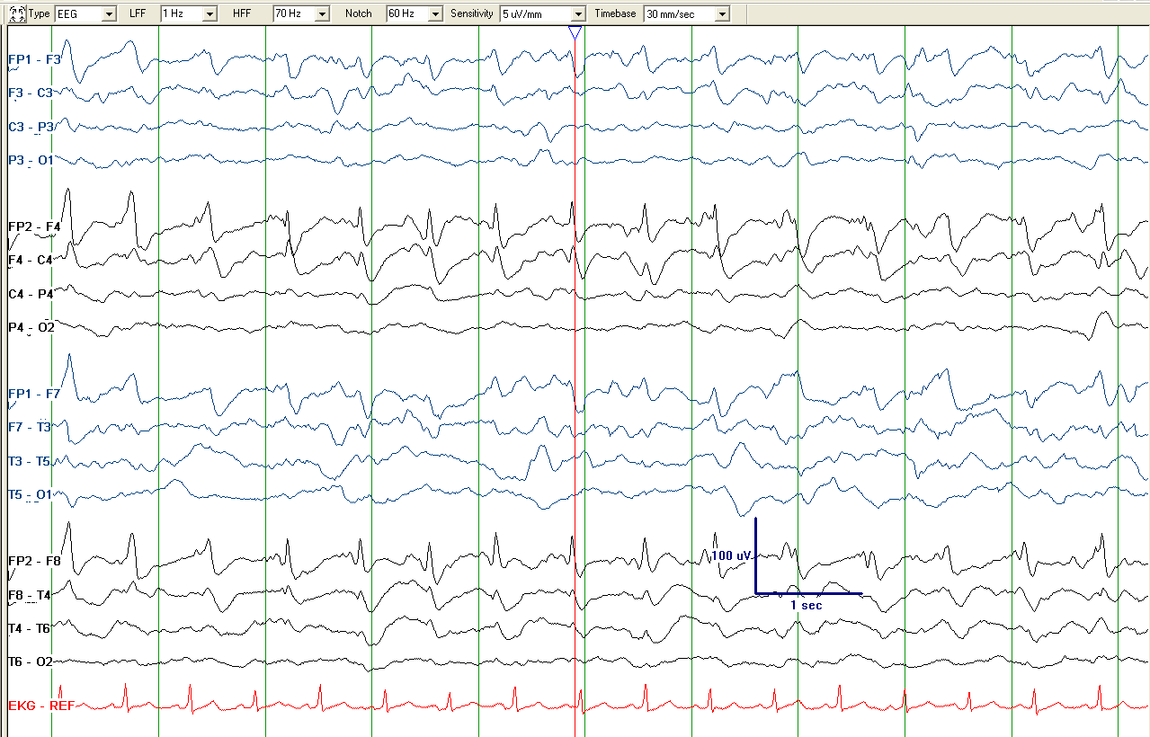
What is the correct term of this pattern?

Slide 57
Sharpness: sharp
Sharpness: spiky
Not LSW since sharp waves are not time locked to delta waves for 6 or more cycles, but close
Rhythmic activity
Lateralized Periodic Discharges with superimposed Rhythmic Delta Activity: LPD+R
(Lateralized: bilateral asymmetric, spiky and sharp, 1.5 Hz)

Slide 58
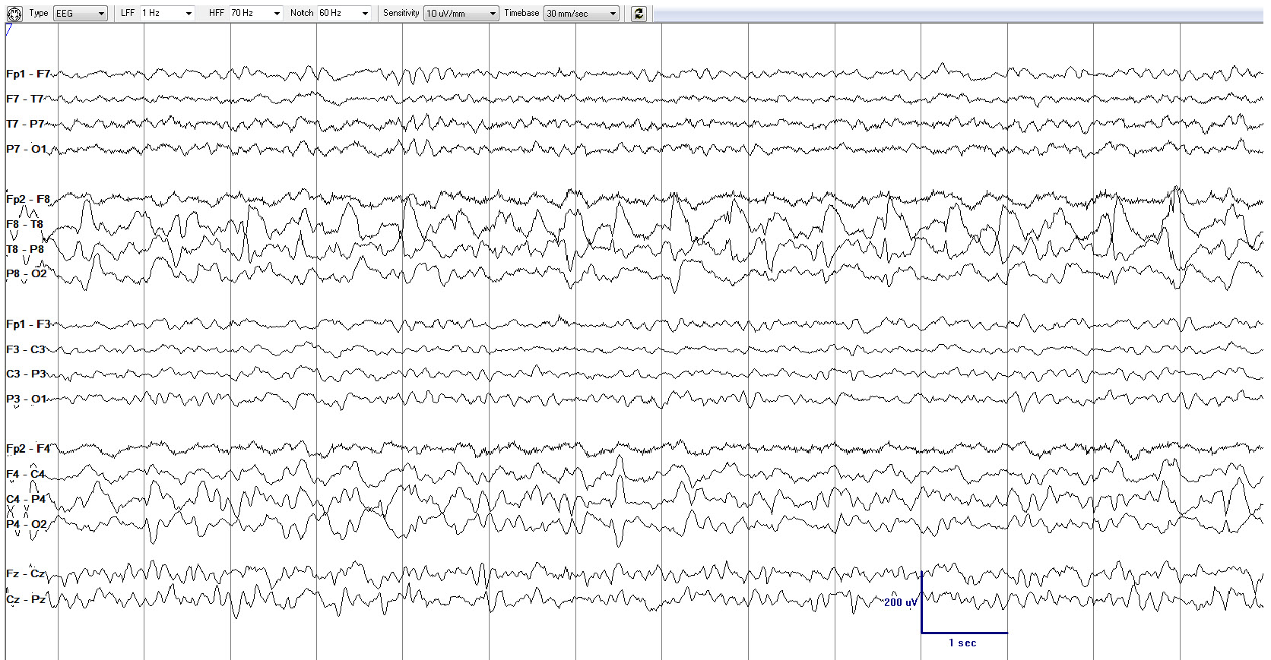
Please describe the pattern

Slide 59
Rhythmic activity
24 discharges in
14 seconds → 1.5 - 2 Hz
Lateralized Periodic Discharges + R (Ictal-Interictal Continuum, IIC)
1.5-2 Hz LPD+R, therefore on the ictal-interictal continuum (discussed later); not >2.5 Hz and not evolving, so does not qualify as a definite electrographic seizure, even though there is a reasonable chance it could cause symptoms or neuronal injury.

Slide 60
EXTREME DELTA BRUSH (EDB)
“Extreme Delta Brush (EDB)”: A specific subtype of +F:
Definite EDB: Consists of either abundant or continuous:
A. RDA+F, in which the fast activity has a stereotyped relationship to the delta wave (e.g., always maximal
on the upstroke, crest, or downstroke of the wave);
OR
B. PDs+F, in which each PD consists of a single blunt delta wave with superimposed fast activity, and in which
the fast activity has a stereotyped relationship to the delta wave (i.e., periodic delta brushes)
Possible EDB:
Satisfying criterion A) or B) above EXCEPT either:
i. only occasional or frequent (rather than abundant or continuous)
OR
ii. the superimposed fast activity lacks a stereotyped relationship to the delta wave; continuous, invariant fast
activity during RDA would fall into this category

Slide 61
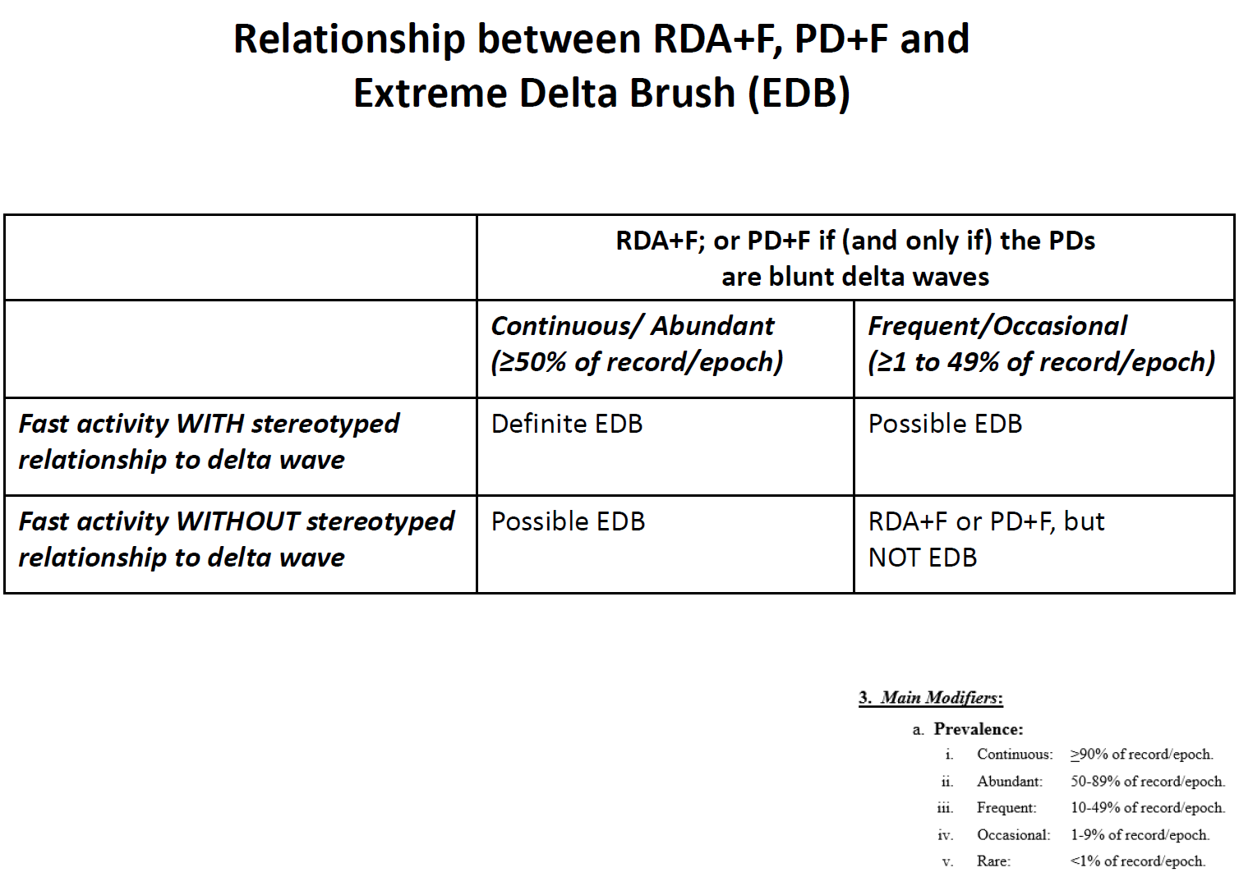

Slide 62
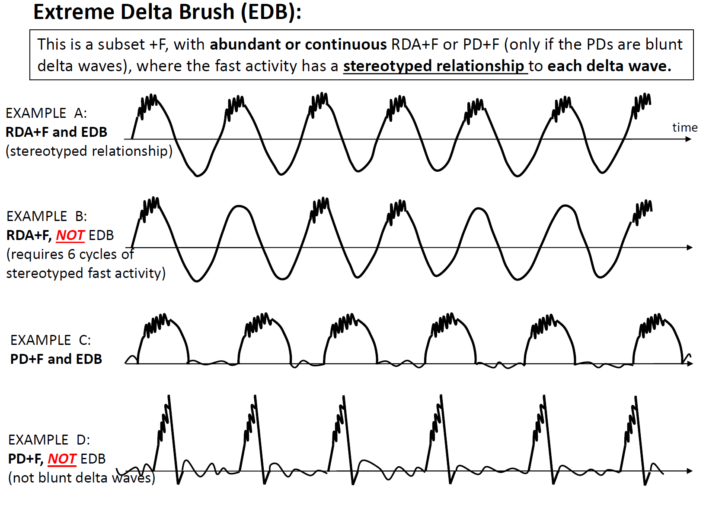
EXTREME DELTA BRUSH (EDB)

Slide 63
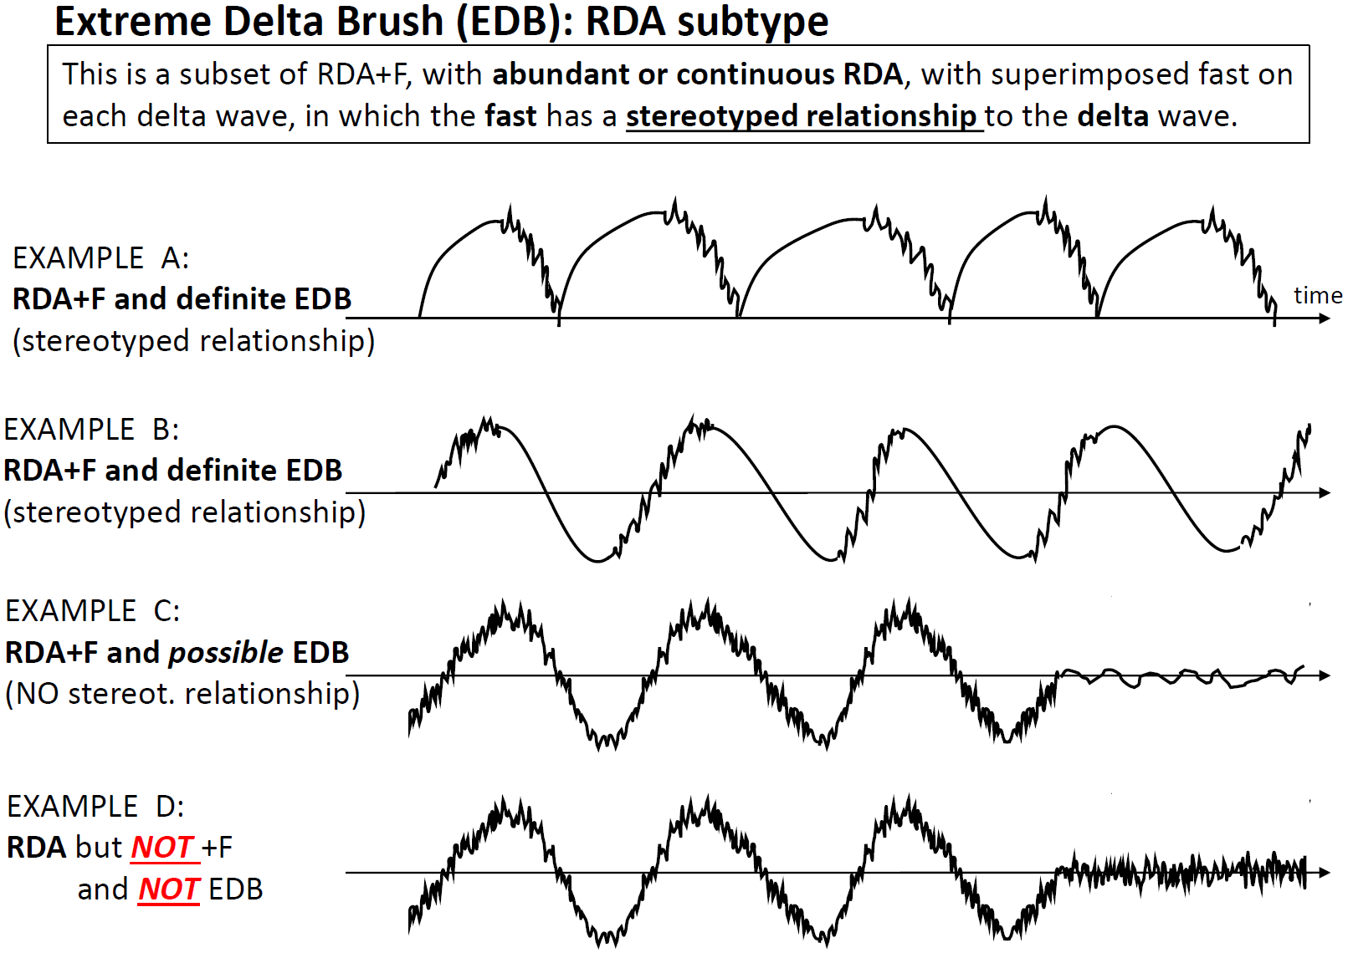
EXTREME DELTA BRUSH (EDB)
This is not +F since the fast activity is present even when the RDA is not.

Slide 64
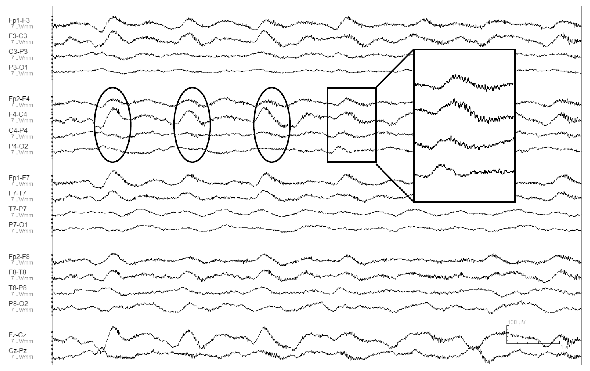
What is the correct term for this pattern?

Slide 65
Periodic blunt delta waves with superimposed beta in a stereotyped relationship to the delta waves.
Generalized Periodic Discharges with superimposed fast activity (GPD+F) (Bifrontal maximum, 0.5 Hz): If abundant/ continuous, this is definite EDB; if it‘s frequent/occasional, it is possible EDB.

Slide 66
MAJOR MODIFIERS: EVOLVING, FLUCTUATING or STATIC
Evolving and fluctuating refer to changes in at least one of the following:
  Frequency
  Location
  Morphology
  (not amplitude alone)
If neither term applies, report as static.

Slide 67
MAJOR MODIFIERS: EVOLVING
At least 2 unequivocal, sequential changes in frequency, morphology or location defined as follows:
Frequency: ≥2 consecutive increases or decreases of ≥0.5 Hz, (e.g., 2 → 2.5 to 3 Hz, or 3 → 2 to 1.5 Hz)
Morphology: ≥2 consecutive changes to a novel morphology
Location: sequentially spreading into or out of ≥2 different standard 10-20 electrode locations
NOTE:
  if evolving and >10s: it’s a seizure.
  If evolving, 0.5-10s and reaches >4 Hz, it’s a BIRD (definite due to evolution)
  If evolving, <10s and never >4 Hz, just use the modifier “evolving”, e.g., “very brief evolving RDA”

Slide 68
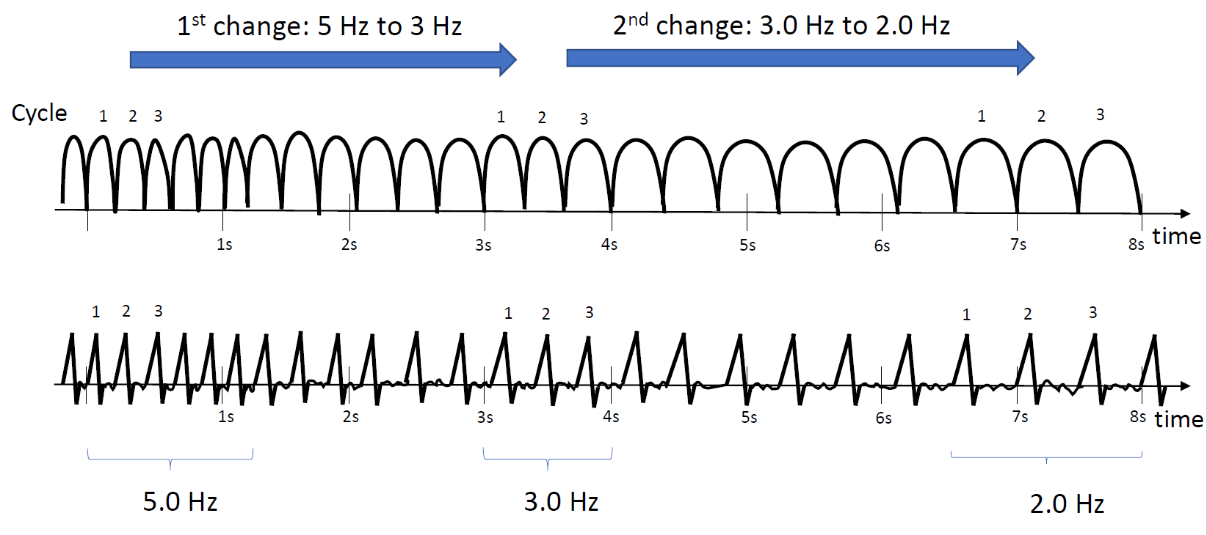
EVOLUTION OF FREQUENCY
At least 2 unequivocal, sequential changes in frequency defined as follows: Evolution in frequency is defined as at least 2 consecutive changes in the same direction by at least 0.5 Hz. In order to qualify as present, a single frequency must persist for at least 3 cycles. The criteria for evolution must be reached without the evolving feature (frequency) remaining unchanged for 5 or more continuous minutes.

Slide 69
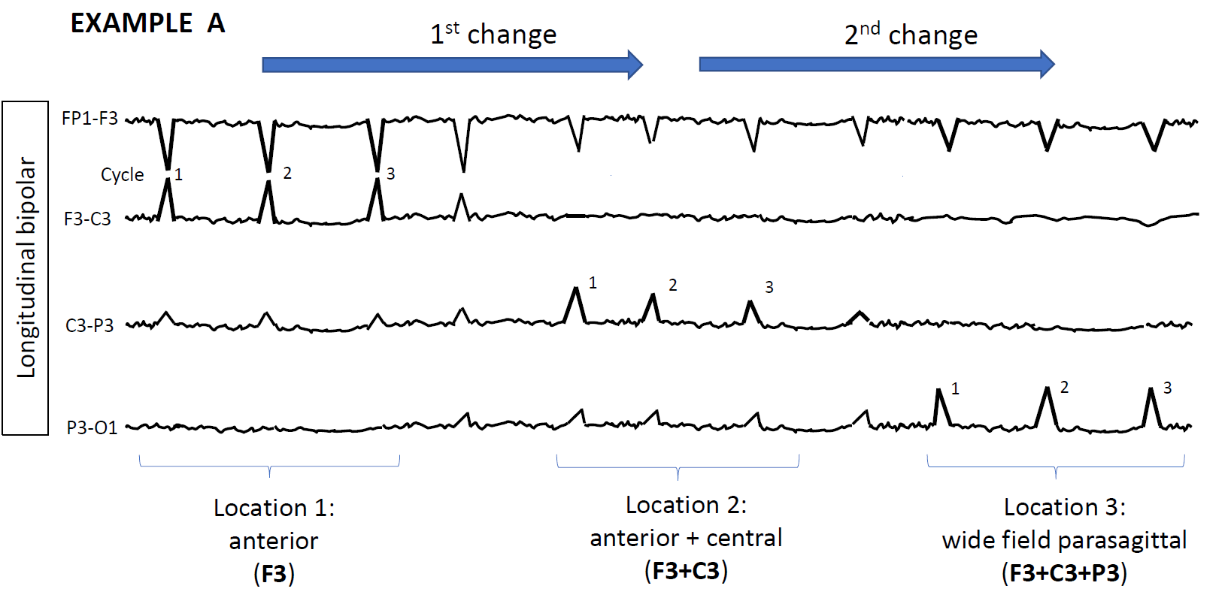
EVOLUTION OF LOCATION
Evolution in location is defined as sequentially spreading into or sequentially out of at least two different standard 10-20 electrode locations. The two consecutive changes must be in the same category (location) to qualify.
In order to qualify as present, a single location must persist for at least 3 cycles.
At least 2 consecutive changes to a novel morphology.

Slide 70
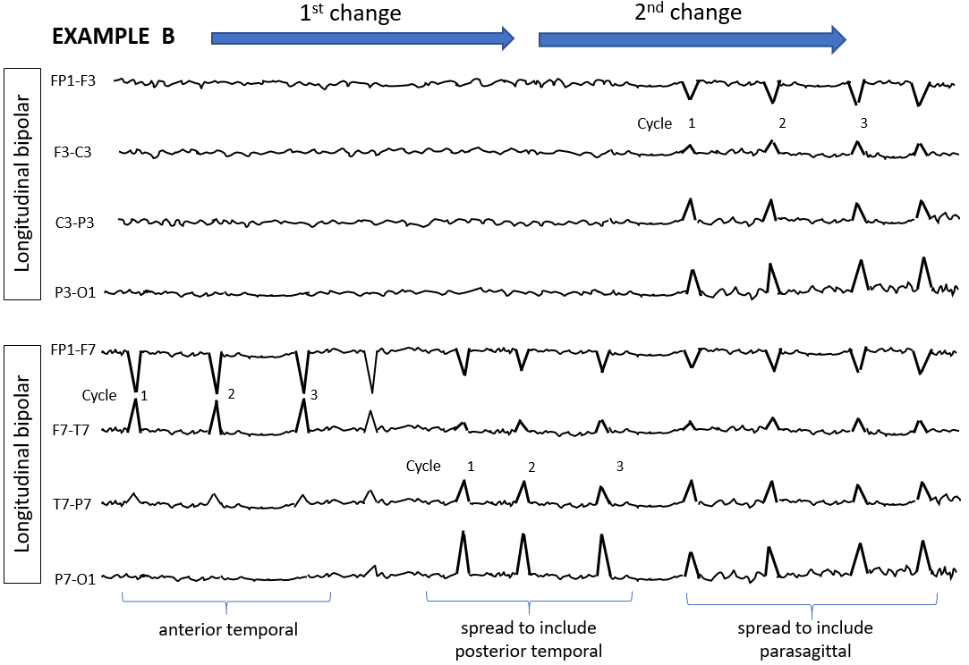
EVOLUTION OF LOCATION
At least 2 consecutive changes to a novel morphology.

Slide 71
MAJOR MODIFIERS: FLUCTUATING
At least 3 changes, <1 min apart, in:
  Frequency (by ≥0.5/s),
  Morphology, or
  Location (by ≥1 standard inter-electrode distance),
  BUT not qualifying as evolving.

Slide 72
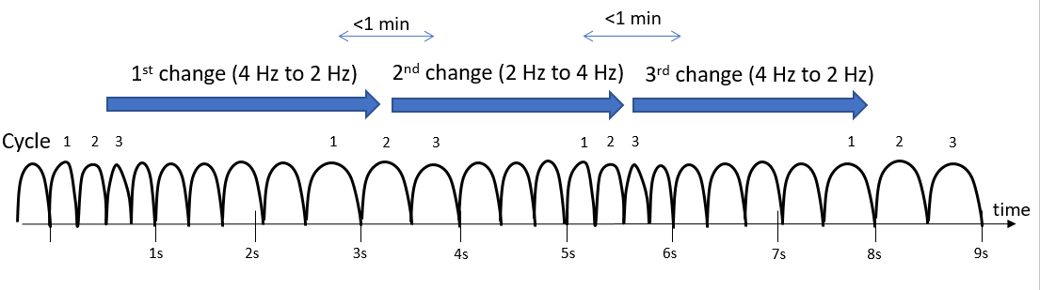
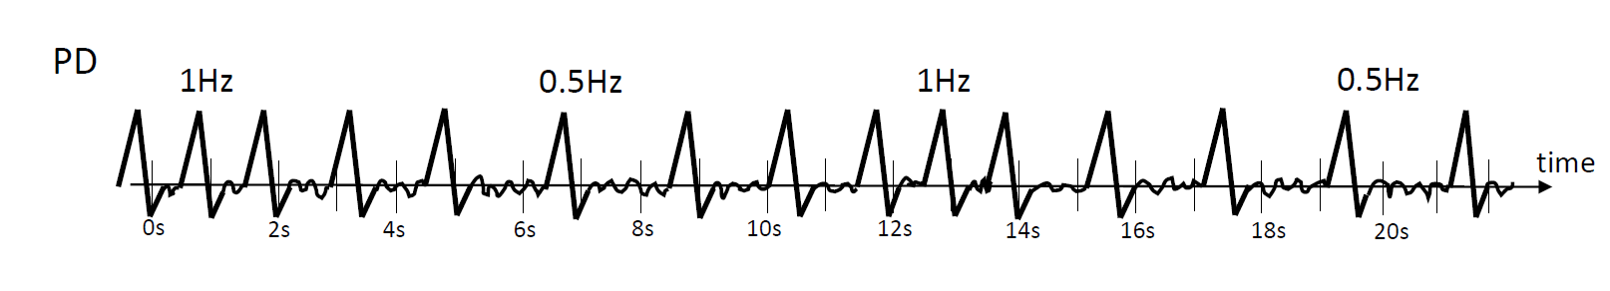
FLUCTUATION in FREQUENCY
>3 changes, not more than one minute apart, in frequency (by at least 0.5 Hz), but not qualifying as evolving.
This includes patterns fluctuating from 1 to 1.5 to 1 to 1.5 Hz.
In order to qualify as present, a single frequency must persist at least 3 cycles (e.g., 1 Hz for 3 s, or 3 Hz for 1 s).

Slide 73
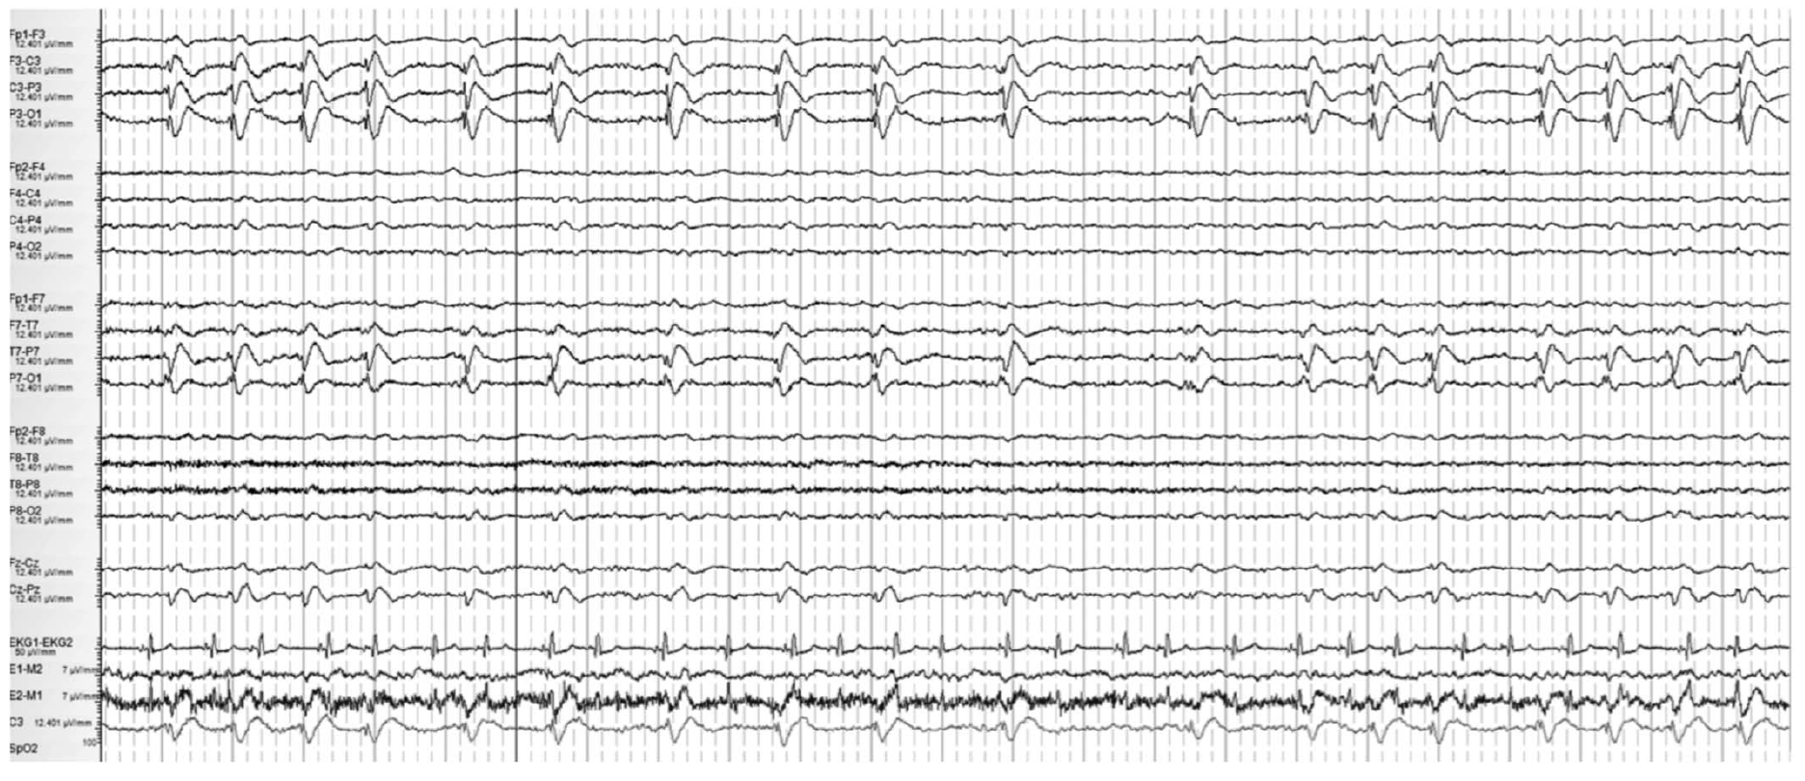
Please describe the pattern

Slide 74
<1 min
<1 min
1 Hz
0.5 Hz
1 Hz
1st change (1 Hz to 0.5 Hz)
2nd change (0.5 Hz to 1 Hz)
Lateralized Periodic Discharges, fluctuating. This EEG is shown on a compressed time scale to demonstrate LPDs slowing from 1 Hz to 0.5 Hz for <1 minute (1st change) and then accelerating back to 1 Hz (2nd change). This patient had fluctuating LPDs but in order to qualify as fluctuation there would have to be at least 3 changes not more than 1 min apart (3rd change not shown).

Slide 75
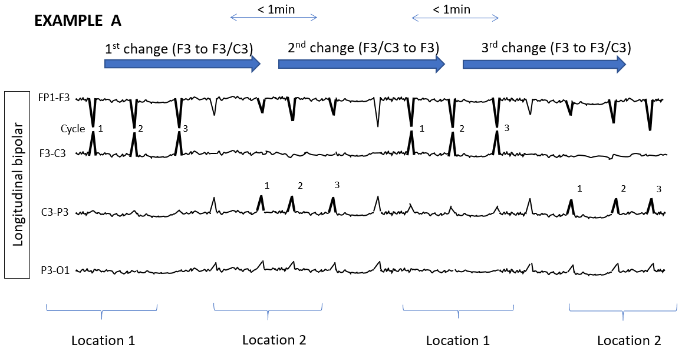
FLUCTUATION in LOCATION
>3 changes, not more than one minute apart, in location (by at least 1 standard inter-electrode distance), but not qualifying as evolving. This includes patterns spreading in and out of a single electrode repeatedly.
In order to qualify as present, a single location must persist at least 3 cycles.

Slide 76
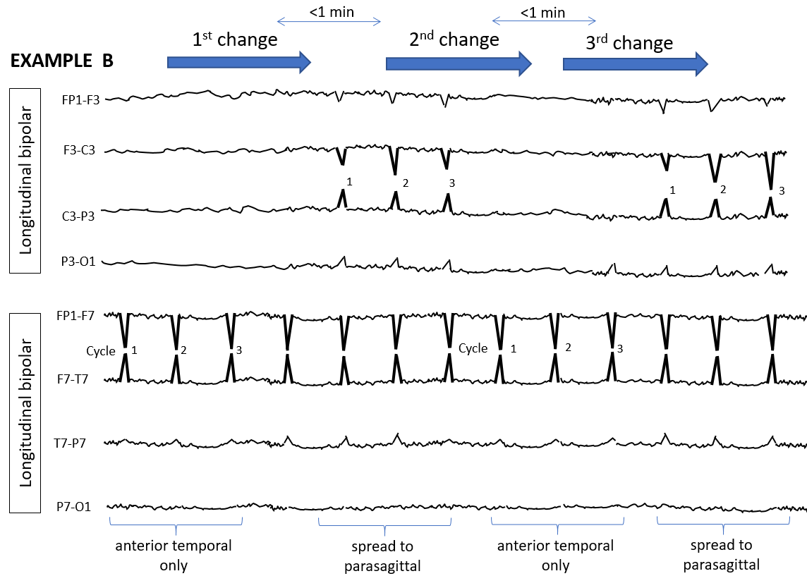
FLUCTUATION in LOCATION

Slide 77
MAJOR MODIFIERS: STIMULUS INDUCED/ TERMINATED
Many patterns including seizures can be reproducibly brought about or exacerbated by an alerting stimulus, with or without clinical alerting, when a patient is in their less-stimulated state. The phenomenon was initially described as stimulus-induced rhythmic, periodic, or ictal appearing discharges (SIRPIDs). Since then, it has become evident that the content of the stimulus-induced pattern, rather than the fact that it is stimulus induced or not, carries the majority of significance. It is therefore encouraged to apply the term stimulus induced (SI-) or stimulus terminated (ST-) to the respective RPPs or seizures, as opposed to referring to them as a collective.
Patterns can be classified as:
  Stimulus induced (SI-)
  Stimulus terminated (ST-)
  Spontaneous
  Unknown, including unclear and untested

Slide 78
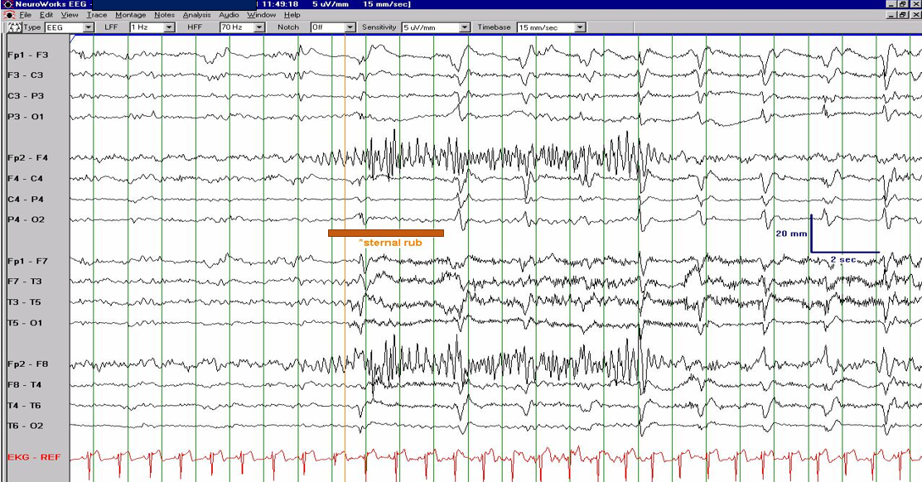
Describe the EEG changes following stimulation with sternal rub at the time of the red bar

Slide 79
Stimulus Induced Generalized Periodic Discharges, SI-GPD
(0.5 Hz)

Slide 80
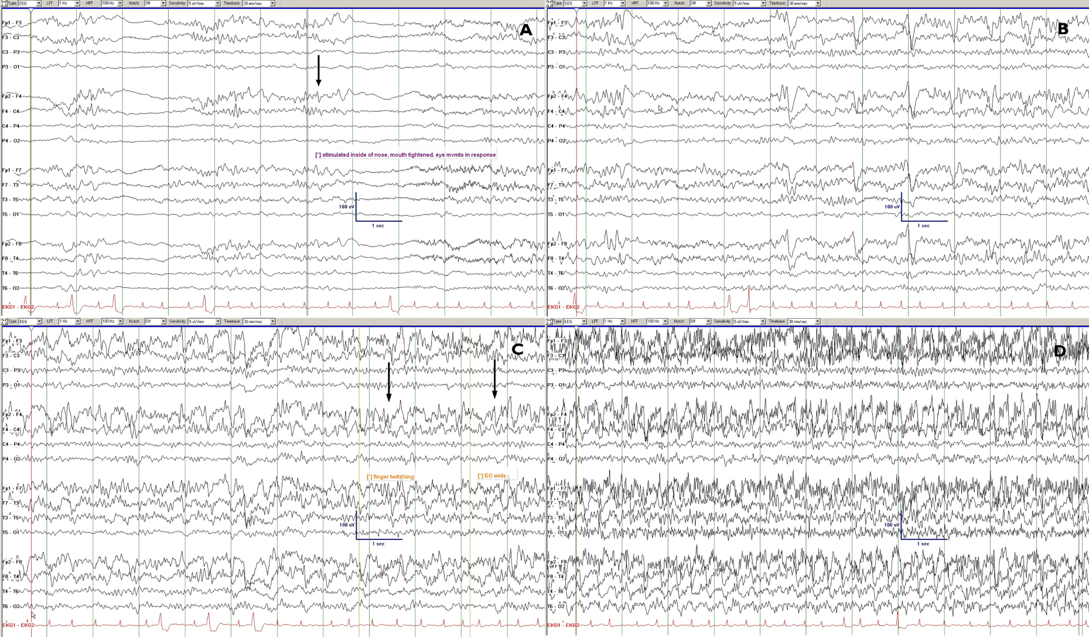
SIRPIDs: example 2B
Please classify the EEG; intranasal tickle was performed in the middle of part A
Reproduced with permission from Hirsch LJ, et al. Epilepsia 2008

Slide 81
SIRPIDs: example 2B
Reproduced with permission from Hirsch LJ, et al. Epilepsia. 2008
Stimulus-Induced Seizure (electroclinical sz.), SI-Seizure: STIM in part A (first arrow) leads to gradual development of a bilateral evolving ictal pattern, bitemporal maximum, over the next 30 secs (B-D), evolution in frequency: 10 hz→ 7 Hz → 4 Hz [end of sz not shown]; clinical correlate: mouth tightened, then finger twitching in left hand only, then eyes opened wide and deviated up and to the right. Recurred whenever stimulated.

Slide 82
END OF PART 2
CONTINUE TO PART 3

